Slide 1
Ekti Bangladesh
-সারাবিশ্বের বিষ্ময় তুমি আমার অহংকার।

Slide 2
Submitted To | Submitted By
Atiya Masuda Siddika Lecturer Dept. of CSE BUBT | Ahmed Mahir Shoaib (18192103235)
 | Abu Zobayer Bin Siddique (18192103226)
 | All Moon Tasir (18192103256)
 | Abdullah Al Noman (18192103255)
 | Julkar Naeem (18192103227)
 | Intake: 41 Section: 6 Dept. of CSE
 | Team: INF1N1T3 V014

Slide 3
Ekti Bangladesh
Foreigners do not have many websites to travel to Bangladesh. That is why this is our small effort to make our country known.

Slide 4
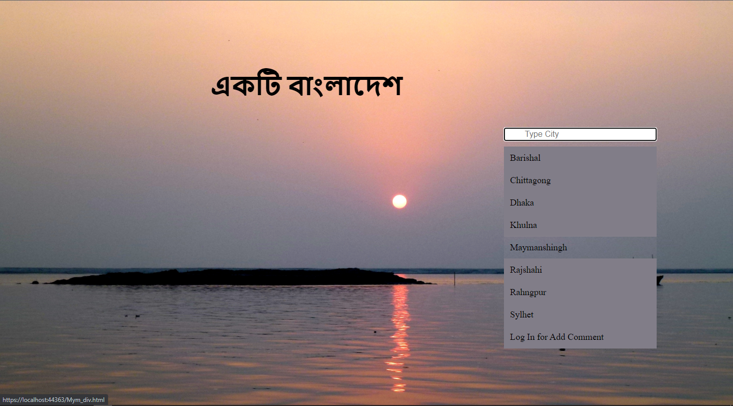
Starting & Home Page

Slide 5
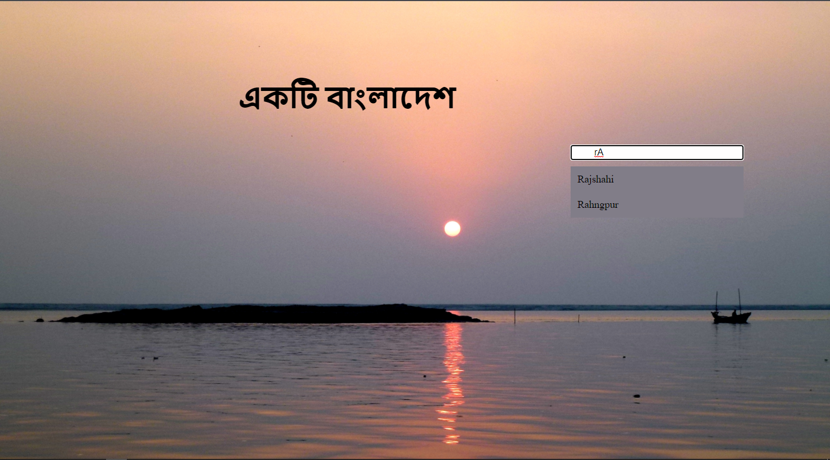
Searching

Slide 6
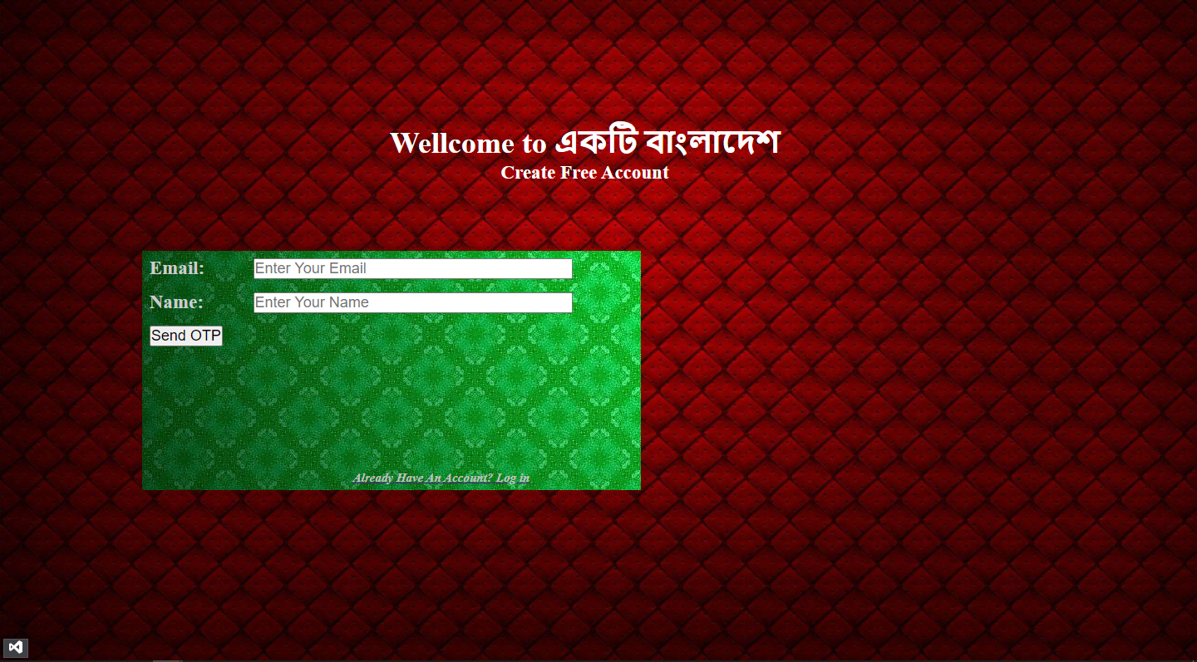
Registration

Slide 7
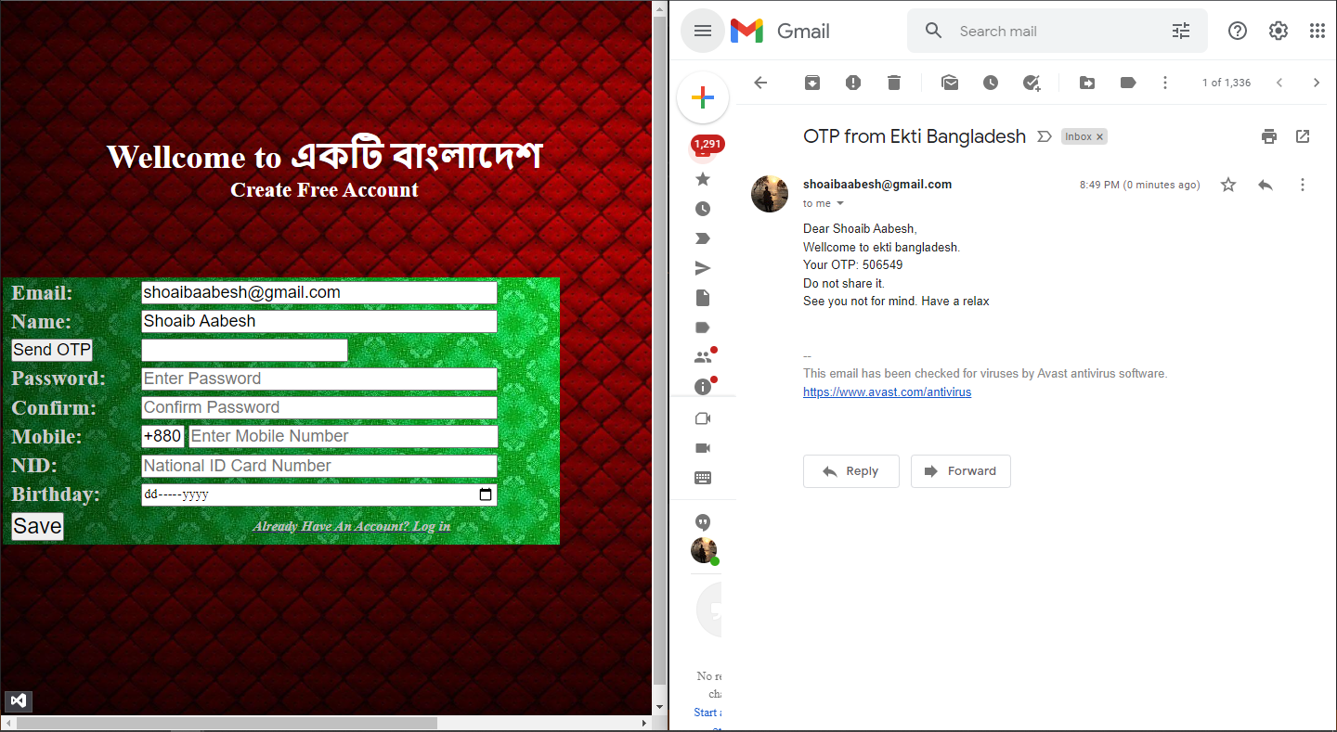
Verification On Registraion

Slide 8
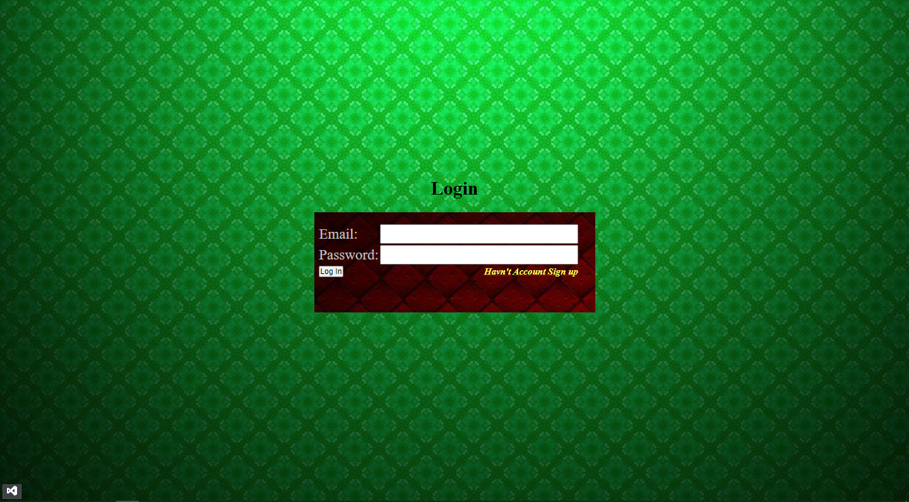
Login

Slide 9
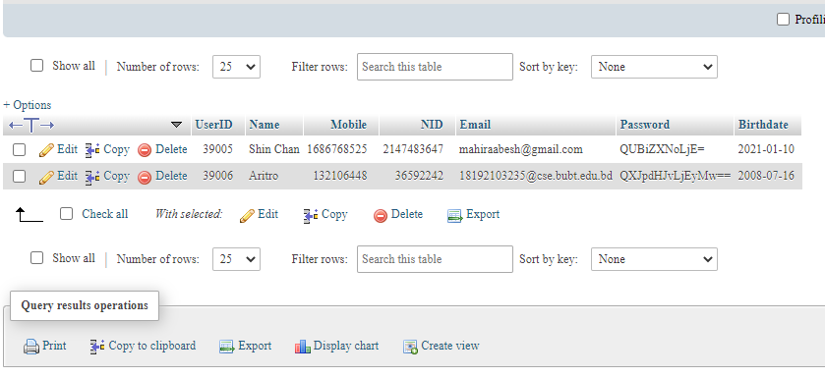
Encryption in Login

Slide 10
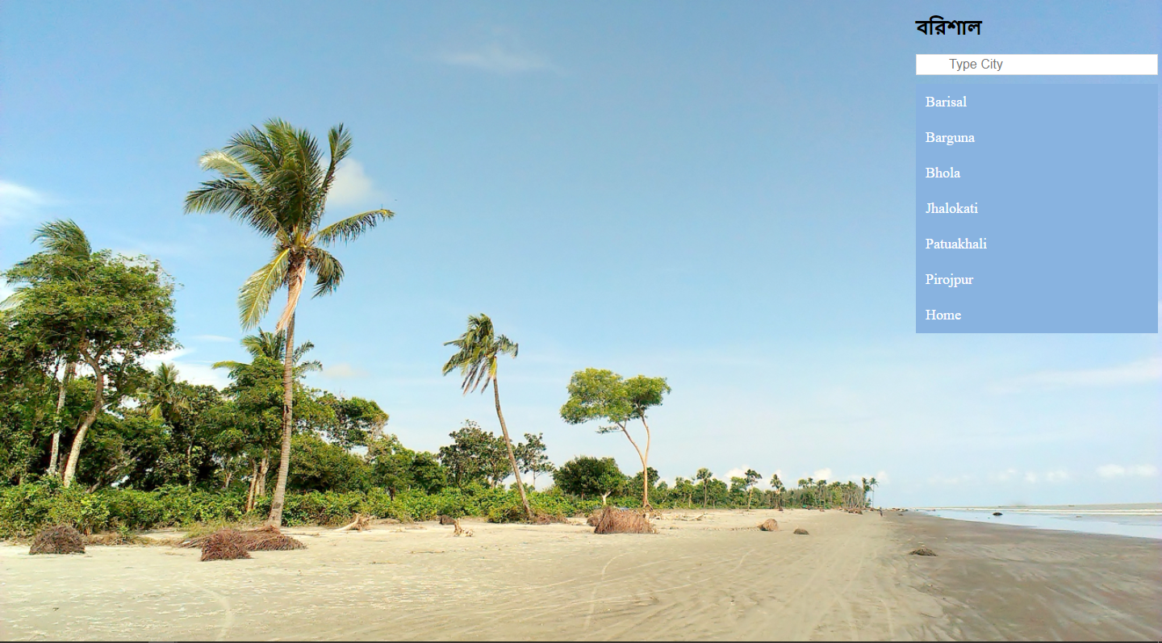
Barishal Division

Slide 11
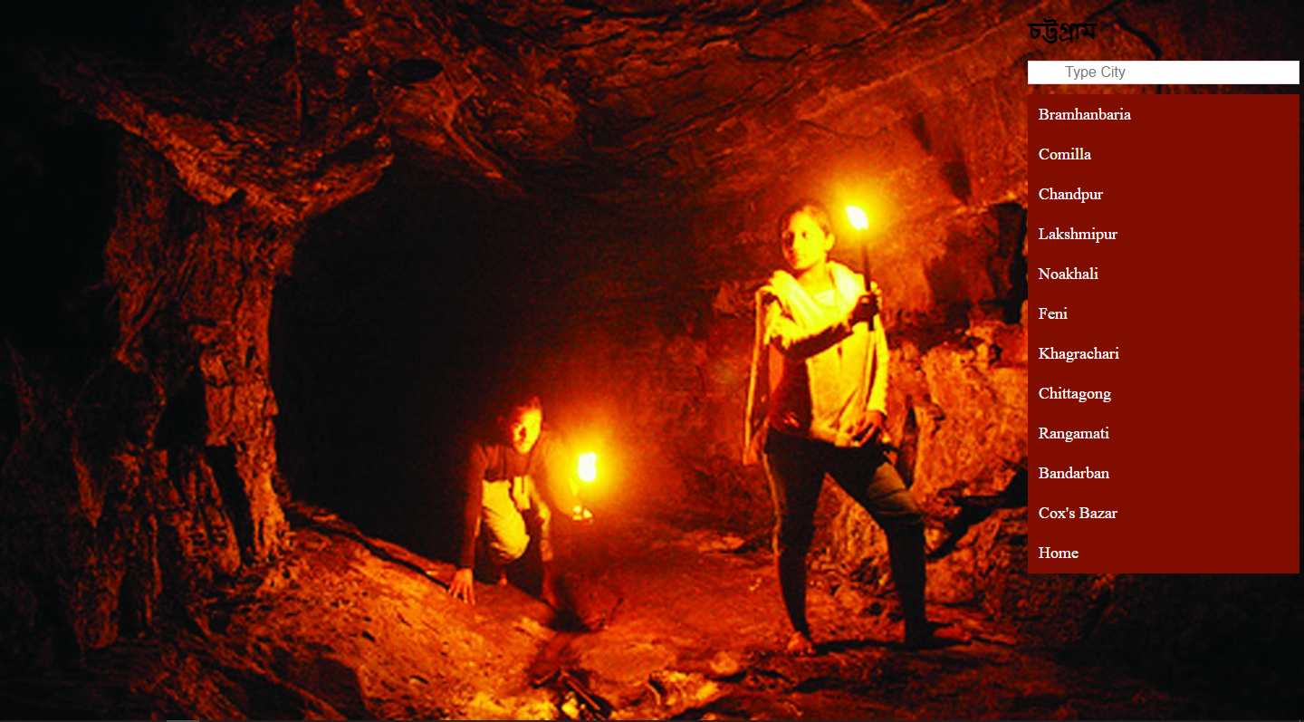
Chittagong Division

Slide 12
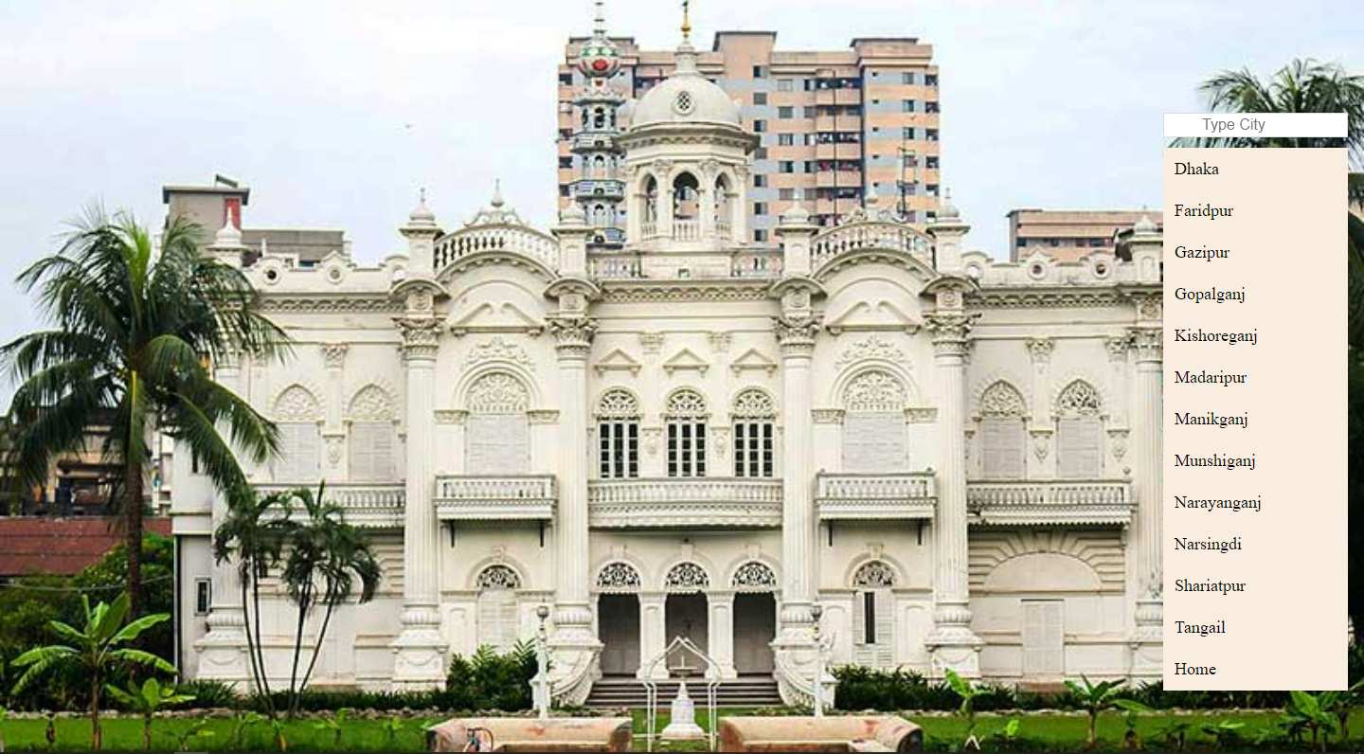
Dhaka Division

Slide 13
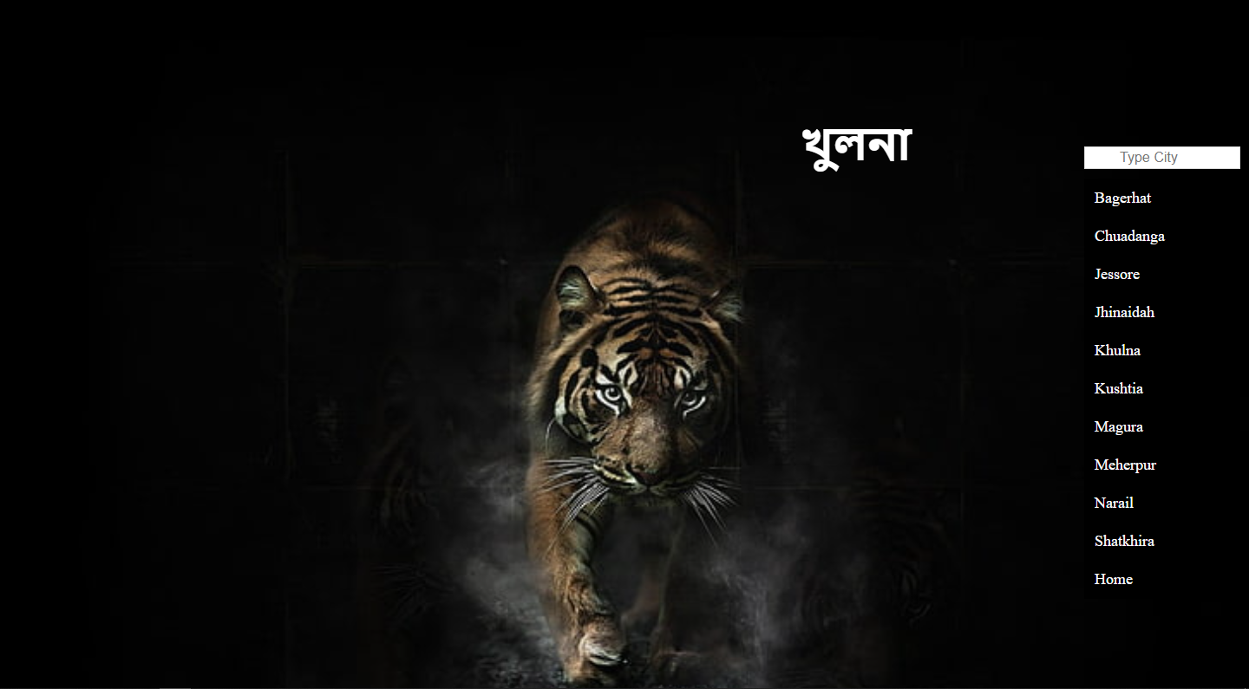
Khulna Division

Slide 14
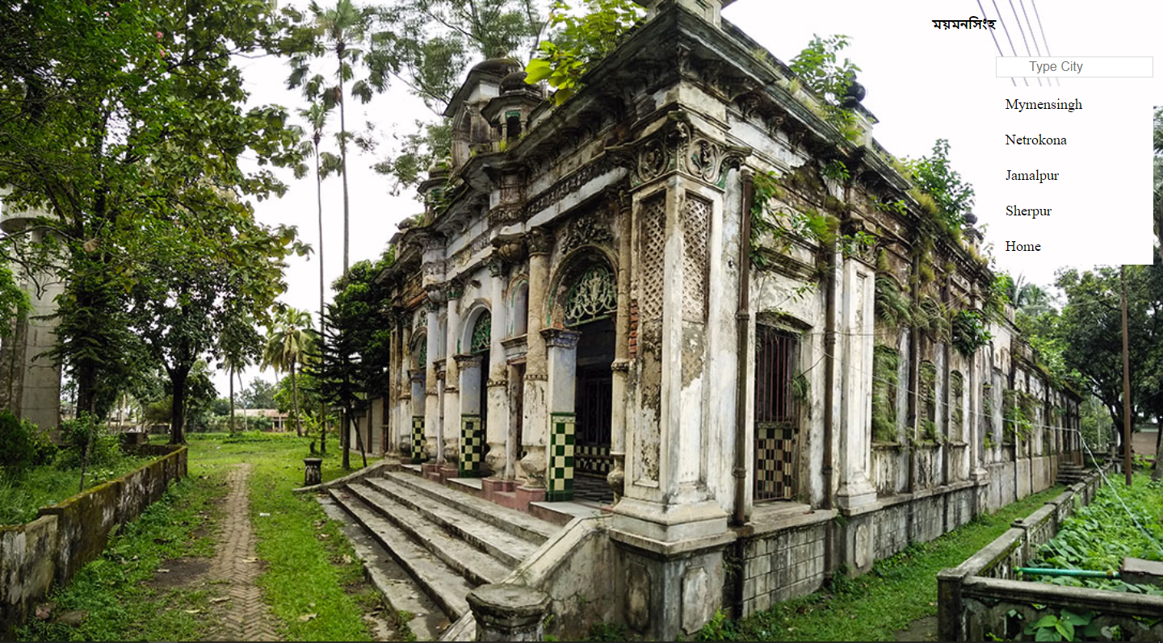
Mymensingh Division

Slide 15
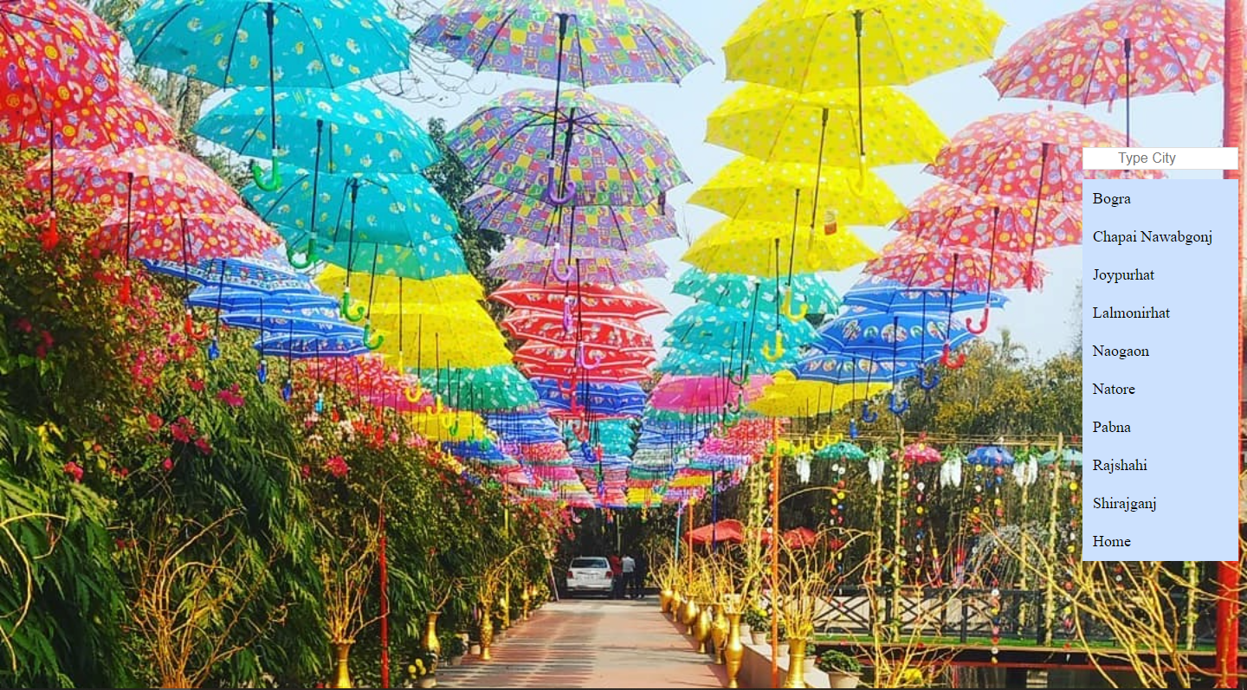
Rajshahi Division

Slide 16
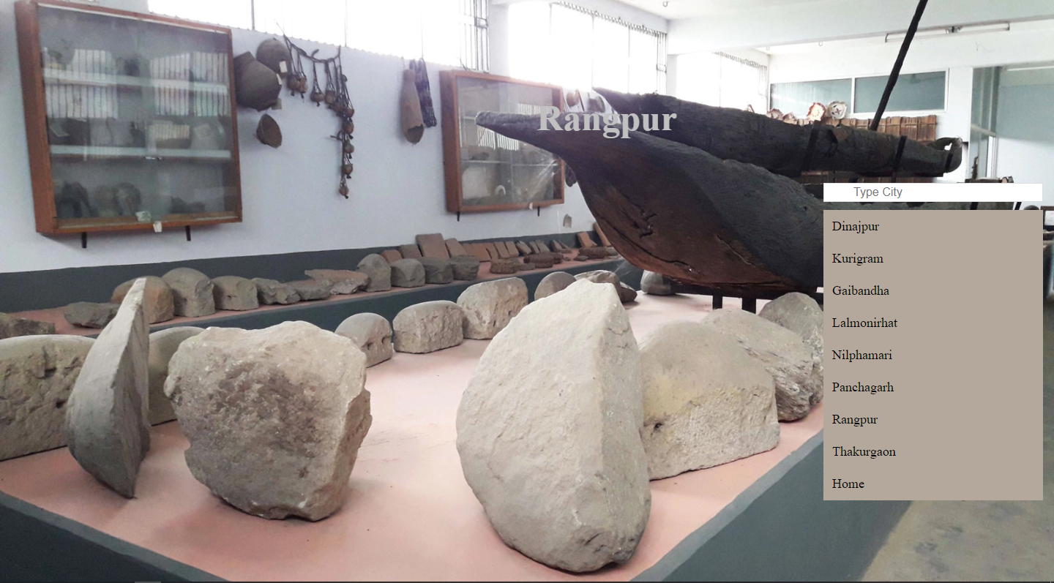
Rangpur Division

Slide 17
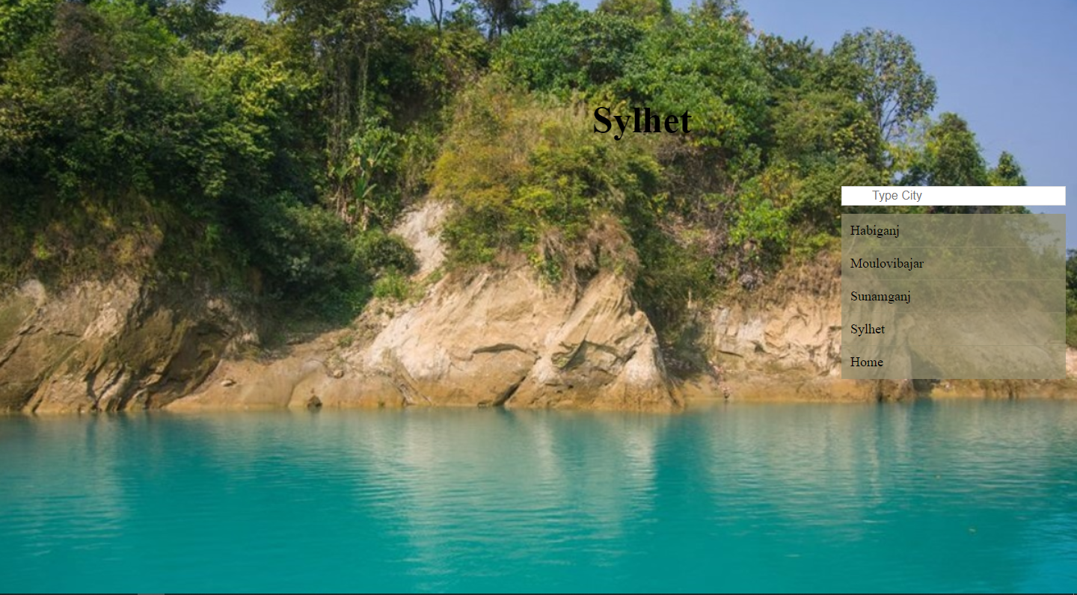
Sylhet Division

Slide 18
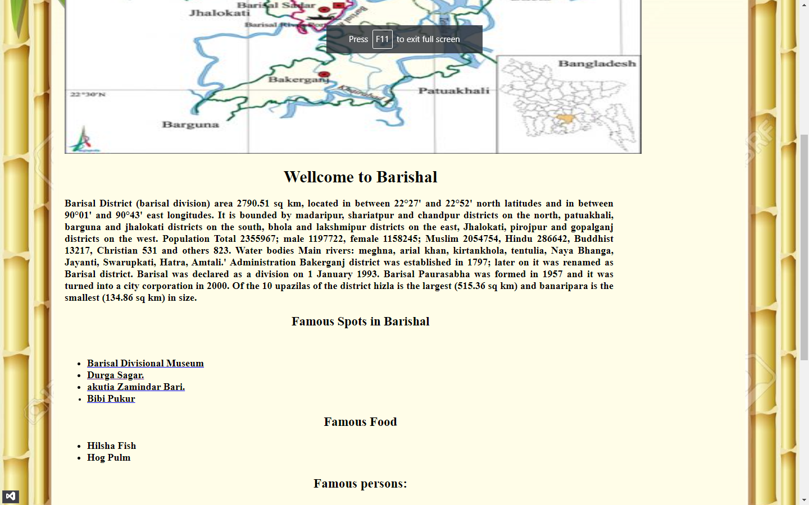
Barishal Zilla

Slide 19
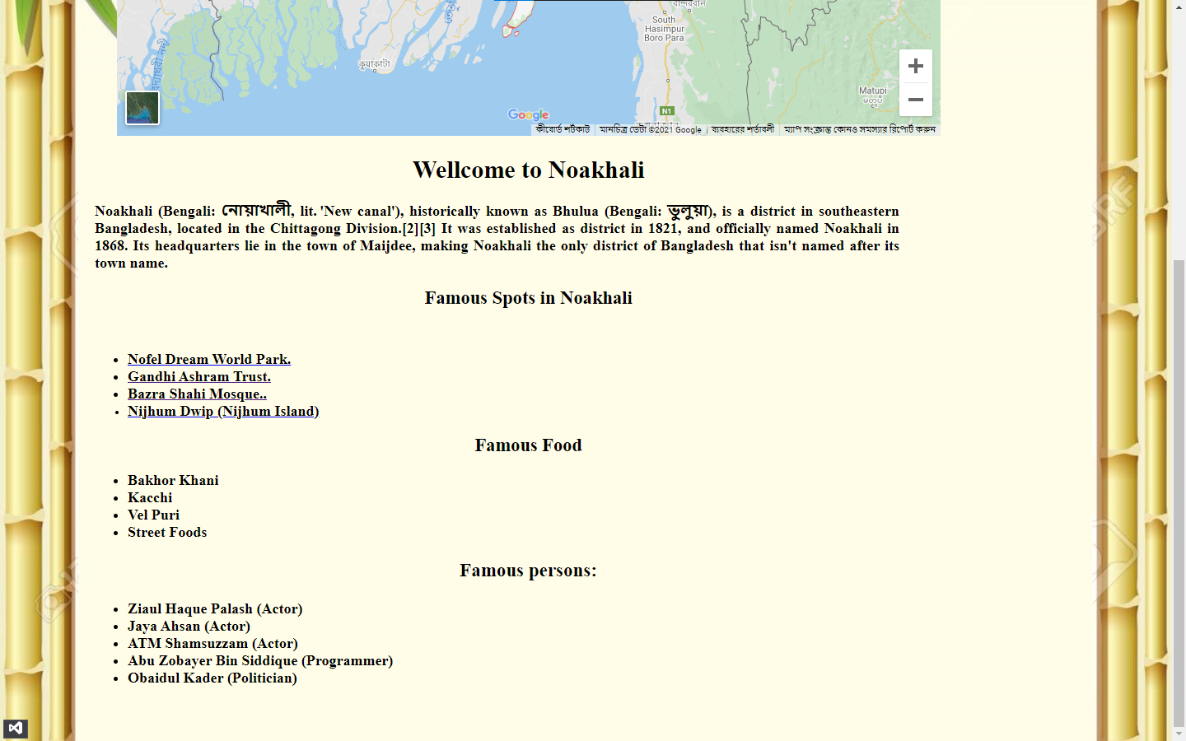
Noakhali Zilla

Slide 20
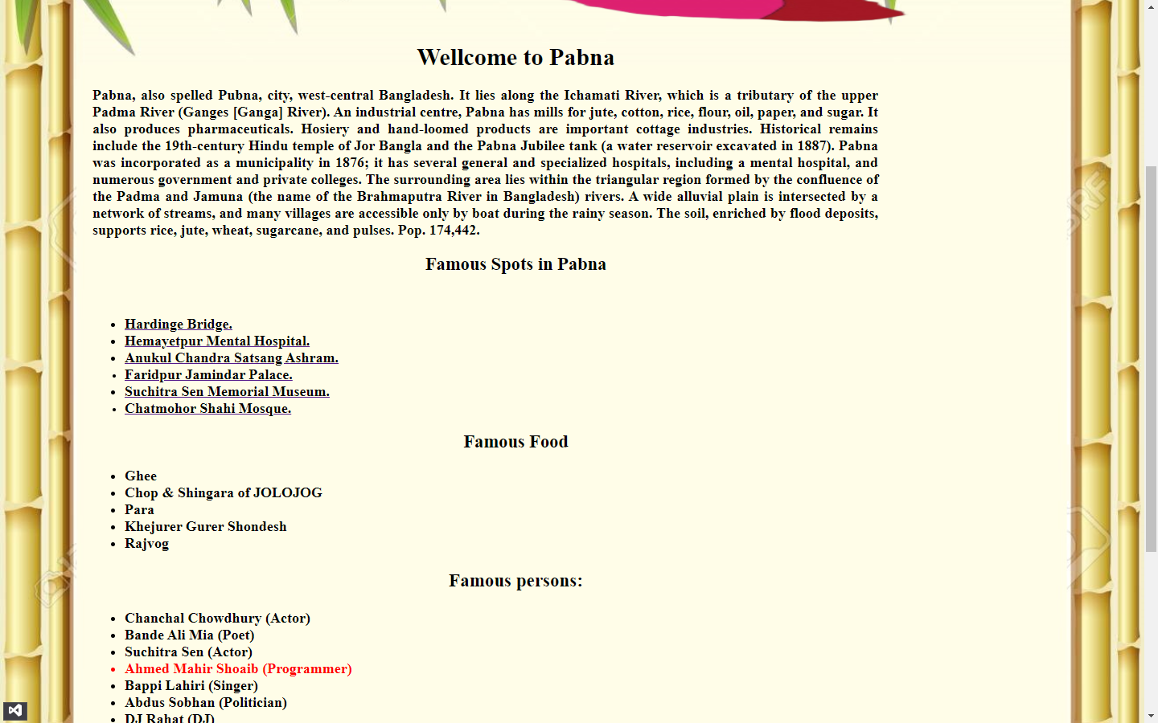
Pabna Zilla

Slide 21
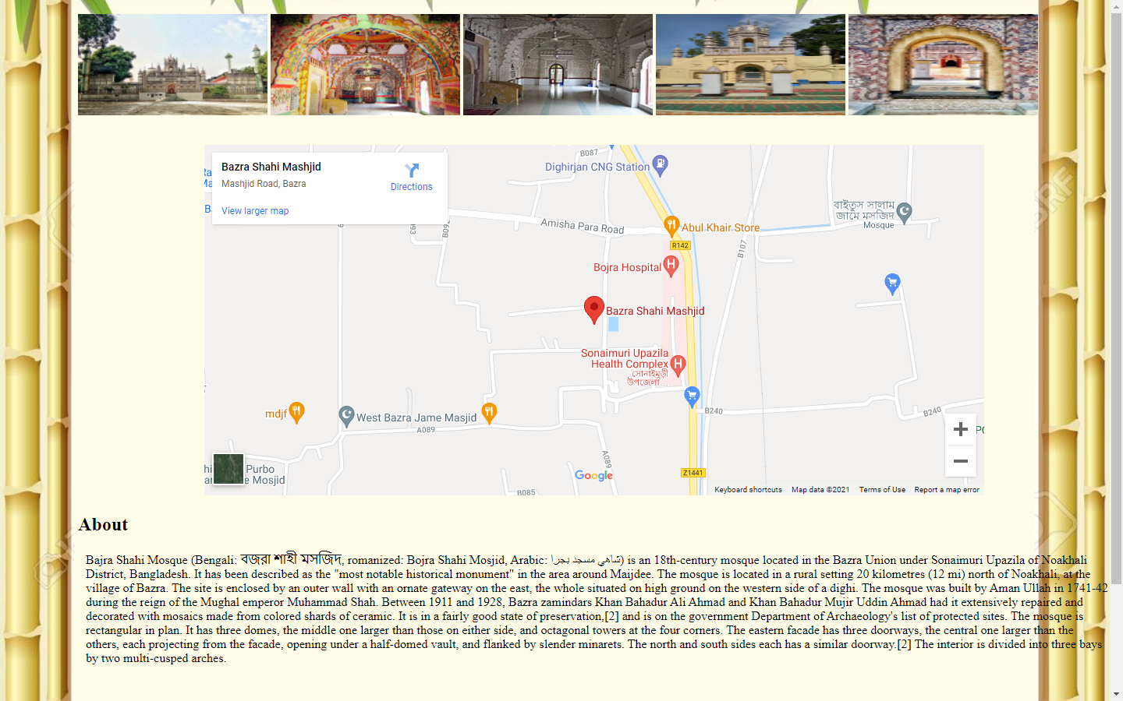
Bojra Shahi Maque (Noakhali)

Slide 22
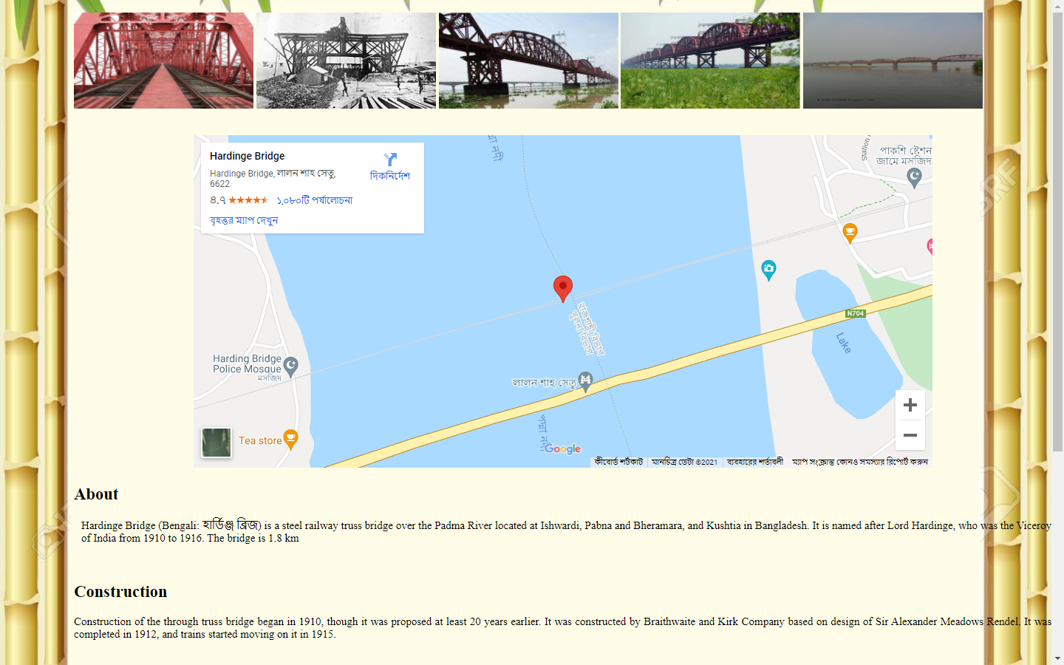
Hardinge Bridge (Pabna)

Slide 23
Future Plan
Add More Information
Add 3d Map
Add More Direction
Add New Interface for Better Design
Updating Data Regularly
Add Language convert

Slide 24
Conclusion
As far as we know, there is no website about Bangladesh where all the information is available together. Besides, there is very little information about Bangladesh in English. That's why we design it to provide all the information together. This will make it easier for foreigners to learn about our country and increase our tourism revenue by travelling to our country. In this way, as our tourism sector will improve, everyone will be able to know about our country.

Slide 25


